Slide 1

Product Name:
Philanthrolink
#FullStackFuture
© NIIT-StackRoute 2023-2024

Slide 2
Abstract Problem
Amid the peak of the COVID-19 pandemic, individuals who were eager to provide aid and support found themselves in a state of helplessness due to the lack of a suitable avenue for donating or contributing to charitable causes.
Hence, create a platform where diverse companies or organizations can share their ongoing or upcoming donation initiatives, specifically targeted at the most pressing needs. This platform would empower end-users or donors to easily access these projects, enabling them to search for donation opportunities based on their priorities, such as projects related to the COVID-19 pandemic. Donors can then contribute funds according to their preferences.
This undertaking not only tackles the obstacles faced during the COVID-19 crisis but also establishes a foundation for a more transparent, responsible, and efficient charitable network.

Slide 3
Pain Points
Lack of payment options : User might face payment issues if difference payment option is not available
Unnecessary advertisements : User might face issues while surfing through site because of unnecessary advertisements
Environmental issue : We don't know from which platform user or organization will use the website, so we need to build all-platform friendly website so that it can work on Mobile/Tablet/Computers etc.
Unavailability of important features : Important features such as search bar, donation type drop down menu, etc should be available so that user (donator) can make choice of their own and not face any issue while doing so
Transparency for both Organizations and donors : Platform/website should be transparent enough so that donator will know where there money is going and organization will know who is donating and then can target their target audience

Slide 4
Pain Points
Lack of Information: Donors had difficulty finding up-to-date and accurate information about ongoing donation initiatives, leading to uncertainty about where to contribute.
Risk of Scams: The absence of a reputable platform exposed donors to the risk of contributing to fraudulent or scam initiatives, causing distrust in the donation process.
Unclear Impact: Donors were left unaware of the real impact of their contributions due to the absence of progress updates and success stories.
Inefficient Resource Allocation: Organizations struggled to allocate resources effectively as they lacked insights into donor priorities and preferences.
Communication Challenges: Donors and organizations faced difficulties in effectively communicating and coordinating their efforts.
Trust : Gaining the trust of both donors and charitable organizations can be challenging.
Difficulty in Verifying Legitimacy: Especially during crises, fraudulent organizations may take advantage of people's willingness to help. Donors need a reliable way to verify the authenticity of charitable initiatives.

Slide 5
Pain Points
Donor Engagement and Feedback: Donors appreciate being kept in the loop about the progress of the projects they support. Without a dedicated platform, maintaining donor engagement and gathering feedback can be challenging.
Complex Donation Processes: Cumbersome donation procedures can discourage potential donors. A user-friendly platform can simplify the donation process and encourage more people to contribute.
Limited Accountability: Donors want to ensure that their contributions are making a real impact. However, without proper transparency and accountability, it's hard to track how their funds are being utilized.
Limited Awareness: Some worthwhile initiatives struggle to gain visibility, preventing them from reaching potential supporters. A platform could help bring attention to lesser-known causes.
Underrepresented Causes: Smaller and lesser-known causes might struggle to gain visibility and attract funding.
Limited Engagement : Donors may want to stay connected with the causes they support beyond making donations, but they lack avenues for ongoing engagement.

Slide 6
Pain Points
Privacy Concerns : Donors may hesitate to provide personal information due to concerns about privacy and data security.
Unbanked Populations : Some potential donors, especially in developing regions, might lack access to traditional banking systems for online donations.
Lack of Micro-Donation Options : Not all donors can afford large donations, and micro-donation options might not be readily available.
Hard to Donate: During COVID-19, people struggled to find a way to donate to charity, leaving them feeling helpless.
Difficulty in Finding Relevant Donation Opportunities:donors faced challenges in identifying ongoing or upcoming donation initiatives that aligned with their priorities.
Not Sure Where Money Goes: People couldn't see where their donations were going, making them unsure about supporting causes.
Missed Chances to Help: Many who wanted to help couldn't, due to the lack of a clear platform to donate effectively.

Slide 7
Pain Points
Spam mails and messages : some time when the user logs in to such websites, the user starts getting spam mails and messages that may lead to different types of frauds.
Unnecessary information : Some time this websites may take different type of unnecessary informations, which are hectic to fill and may let to other risks.
Good Customer services information: Sometimes the user faces some technical problems during donating an amount of money, but were unable to receive any help due to poor or outdated informations provided in the website
Transparency with the money donated : Sometimes when donated through this websites proper information regarding the payment and not provided. Proper receipt or other means should be provided to the donor for a clearer view

Slide 8
Core Problem
We need a public fundraising website (platform) on which organizations can post about their campaigns for their targeted audience and users (donators here) can donate in fundraising campaigns in which they are interested.

Slide 9
User Experience (What can constitute bad experience? Why won’t a user visit again? (Non-Technical)
Unavailability of different payment options and online platforms
Lack of transparency for donators and not auditing the campaigns
Unnecessary advertisements
Hidden fees that is not mentioned in base donation
Lack of different currency option as audience will belong to different countries and will donate in different currency so unavailability of different currency option will be an issue
Long forms and taking unnecessary personal data
Wrong information or outdated information about the campaign ( weak communication bridge between company/organization and donator

Slide 10
User Experience (What can constitute bad experience? Why won’t a user visit again? (Technical)
Server issues
Unsafe payment options
Laggy website
Dead UI/UX ( Environment issue, etc )
Functional difficulties ( such as Login and registration issues )
Data integrity
Lack of interactive features
Poor match making between donors and campaigns/initiatives

Slide 11
Event Storming
Data leakage
Unsafe transaction
Promotion
Platform friendly
Reusability of code
Fund raiser
Campaign
Funds
Donations
Withdraw
Sign in
Register
Treatment

Slide 12
Event Storming
Filters
Social media
Research
Organ donation
Setup
Tutorial
Payment options
Crowd funding
Talk to us / contact us
Dashboard
Privacy
Conditions of use
emergency

Slide 13
I Like (Benchmark Systems) ( Website 1: Millap Org ) ( URL: https://milaap.org )
User interface
Option available for different currencies ( INR/USE/CAD)
Asking for only necessary data from users ( name/email/phone no. )
Transparency ( Donor will know how much fund was raised and regular updates regarding the campaign )
No advertisement
Availability of Search bar ( donor can search for campaigns in which they are interested or want to donate )
Different payment methods ( Bank transfer / UPI / cards )

Slide 14
I Wish (Benchmark Systems) ( Website 1: Millap Org ) ( URL: https://milaap.org )
More frequent updates regarding campaign
Easy communication with organization or campaign leaders
Dark mode
Should be more compatible with all the resolutions and environment
Lack of information on Blood donation campaign and other similar campaigns

Slide 15
I Like (Benchmark Systems) (Website 2:) (URL:https://www.ketto.org/ )
Secure login
Proper information
Multiple currencies available for donation
Proper contact services for customers
Quick response for customers
Mobile compatibility

Slide 16
I Wish (Benchmark Systems) (Website 2:) (URL:https://www.ketto.org/ )
Secure login page for donors
Easy interface for better experience
Sharing on social media
Adding some more functionalities like deleting an already posted fundraiser
Donating on a particular category so that website will responsible for donation

Slide 17
Identify the Stakeholder of the Product (Persona)
Financially stable people.
NGOs
Youth and student groups
MNCs
Volunteers
Environmental enthusiasts
Local communities
Medical research enthusiasts
Media and promoters
Art and culture enthusiasts
Beneficiaries and recipients
People with political background
Educational Institutes
Religious supporters
International supporters

Slide 18
High Level Features
As a User, I should be able to Register and login on the platform.
As a User, I should be able to create/delete/update a profile(register)
As a User, I should be able to find projects aligned with interests and priorities.
As a User, I should be able to access multiple donation options such as one-time donations, recurring donations, and micro-donations and Allow for different payment methods.
As a User, I should be able to get a trustworthy and secure payment gateway
As a User, I should be able to get real-time updates on the progress of projects
As a User, I should be able to share my contributions on social media platforms to encourage others to join in.
As a User, I should get informed about new projects, project milestones, and important updates via email or app notifications.
As a User, I should get multi-language support.
As a User, I should get a support section to assist with any questions or concerns I might have.

Slide 19
High Level Features
As an organisation, we should be able to create detailed project listings, including project descriptions, images, target amounts, and progress updates.
As an organisation, we should be able to categorize projects based on themes like healthcare, education, disaster relief, etc. Add tags like "COVID-19"
As an organisation we should be able to view the real time progress.
AS an organisation , we should be able to update the contents of a specific project.
AS an organisation, we should be able to administrate control panel for managing users, campaigns, and donations.
As an organisation, we should be able to Implement robust security measures to protect user data and financial information.
As an organisation, we should be able to send updates and thank-you messages to donors.
As an organisation, we should be able to provide feedback and ratings for organizations and their projects.

Slide 20
Microservices Decomposition
Microservices | Database
Authentication-Service | MySQL
User-Service | MongoDB
Donation-Service | ElasticSearch
Email-Service (SMTP PROTOCOL)
Recommendation-Service | Neo4J
Payment-Service | MongoDB
Feedback-Service | MongoDB
Support-Service | MongoDB
Notes:
,
,
,
,

Slide 21
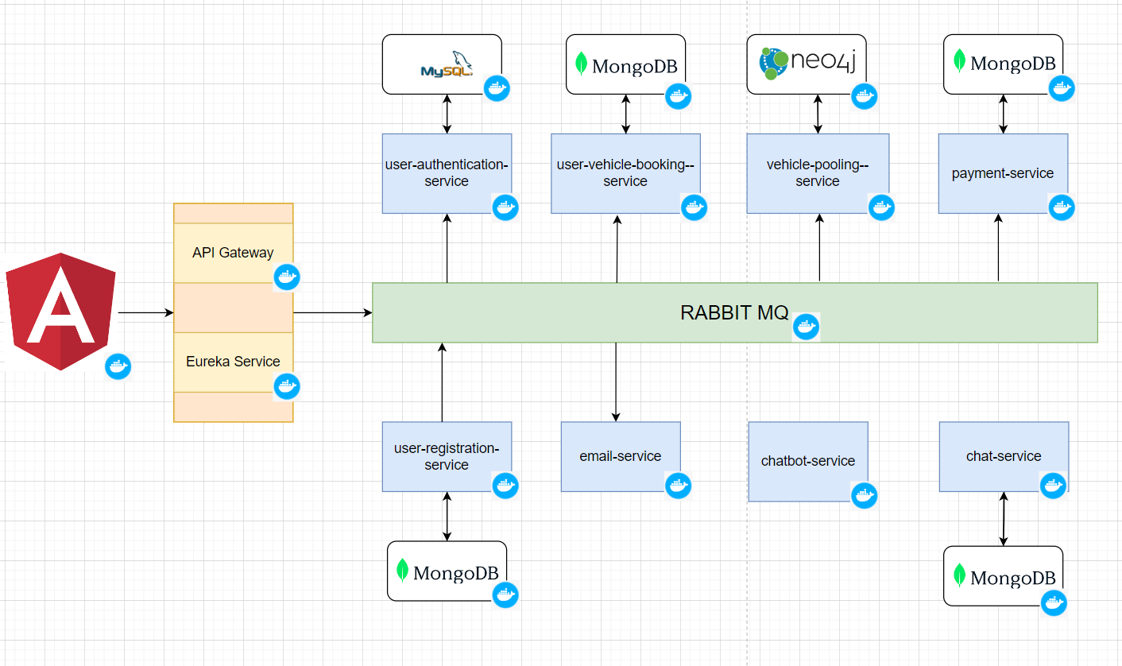
Architecture Diagram (Example)

Slide 22
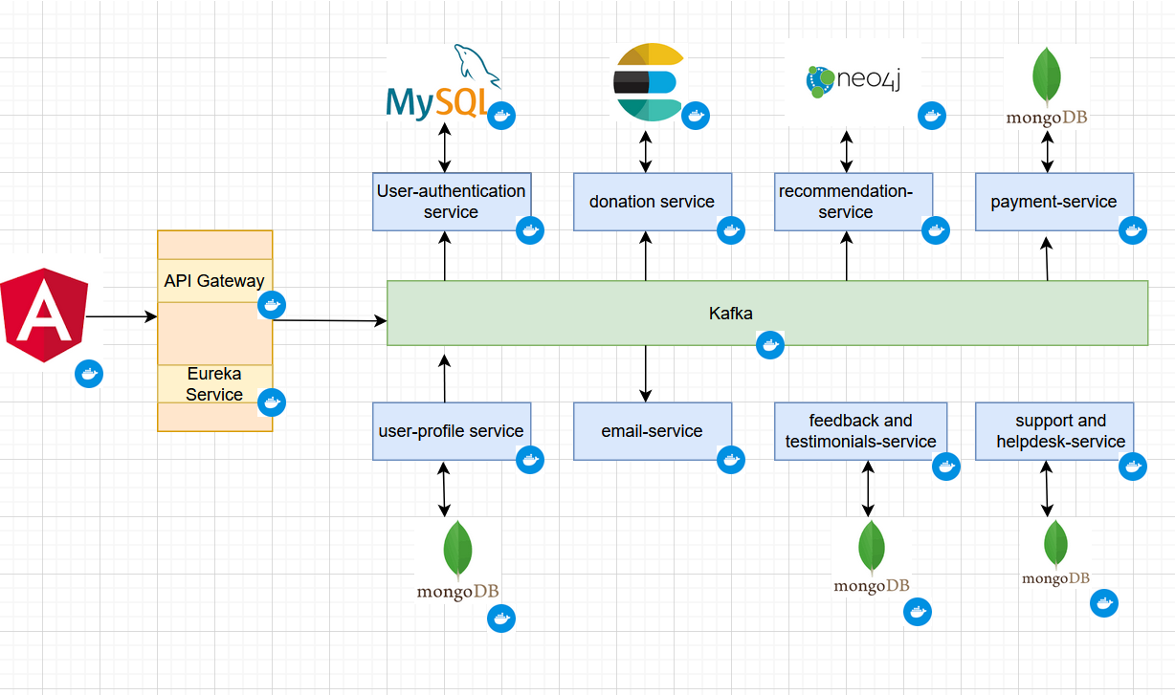
Architecture Diagram

Slide 23
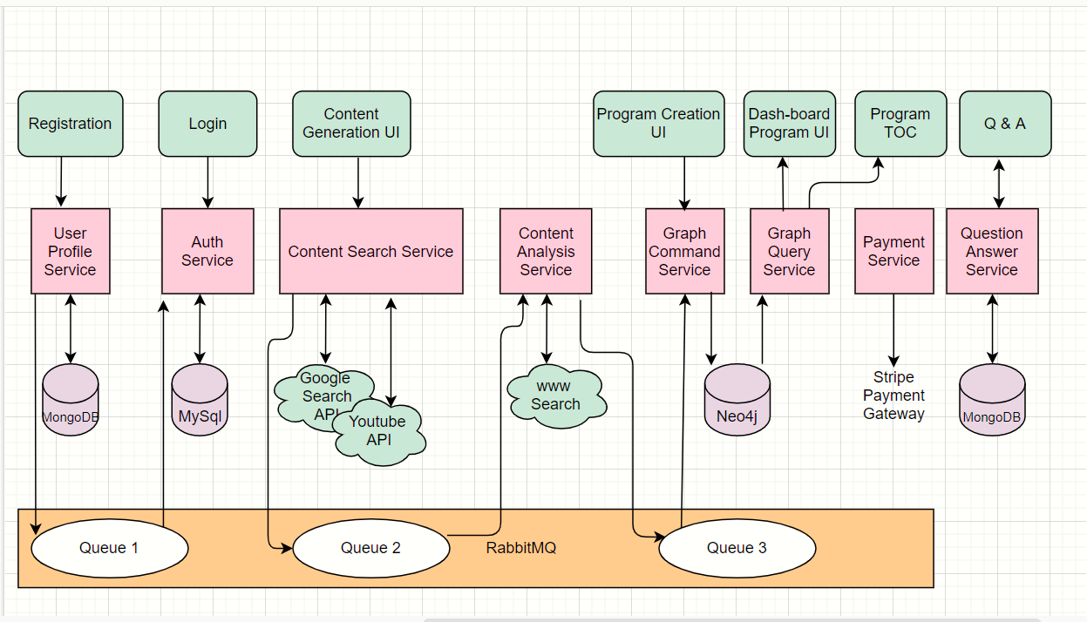
Data Flow Diagram (Example)

Slide 24
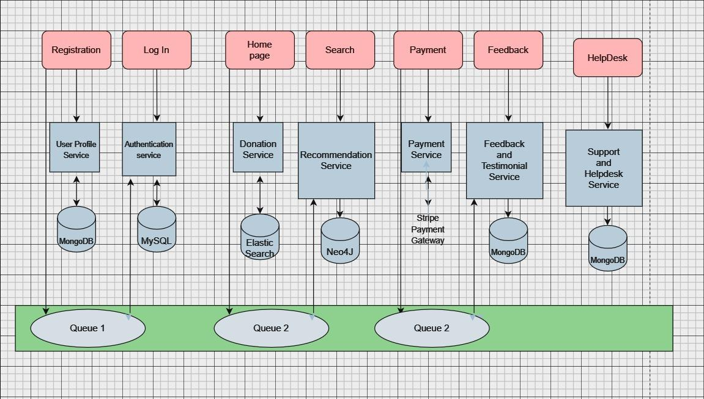
Data Flow Diagram

Slide 25
Product Names
@swayamshreeta ray
Fundlytics
Philanthrolink
@Rama Chandra Varma
"DonorFusion: The Giving Nexus"
"CharityHub: Connect & Care"
@Satyam Kumar Singh
- ElevateCharity
@Pranav
Good Cause Portal
@DivyanshuSingh
LetsDonate
@Giri Prasad
CompassionCrew
HelpingHandsHub

Slide 26
Data Model
https://docs.google.com/document/d/1wA1xXQsYuQ9_wHvNpP-SbEUnj0wKzSaMLJhDIgOtdrA/edit?usp=sharing

Slide 27
Thank You
#FullStackFuture
© NIIT-StackRoute 2023-2024
Notes:
Thank you

